Slide 1
Introduction to Intelligent Experiences
Geoff Hulten

Slide 2

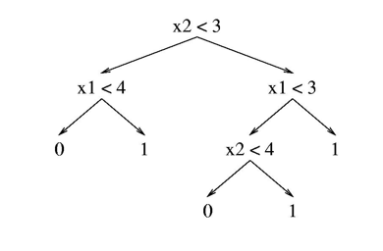







What is an Intelligent Experience
Hello User!
P(LikeSong): 32.612%
Drive the UX
P(LikeSong | User, History)
Raw Prediction
Modes of Intelligent Interaction:
Playing a Song…
Should I Play a Song?
Choose a Song…
Choose a Song…
Yes
No
Automate
Prompt
Organize
Annotate
Which to use?

Slide 3
Why Intelligent Experiences are hard pt 1: There will be Many Mistakes
Mistakes
Experience with Mistakes
97% Accuracy – very, very good
100,000 users with 3 interactions per day:
  9,000 mistakes per day
  63,000 mistakes per week
  3.2 million mistakes per year
Each user expects:
  1 mistake per ~11 days
  ~30-35 mistakes per year
At what point do the mistakes ruin the utility?
Consider each experience two ways:
  What to do if the user got there because the model was right
  What to do if the user got there because the model was wrong

Slide 4
Why Intelligent Experiences are hard pt 2:
The Mistakes Will Change
Intelligence Changes
Problem Changes
You have a better model +2%!
  More things got better than worse
  But some things got worse…
New mistakes
  Randomly distributed?
  Focused on certain users?
  Cheap or costly?
New contexts appear
  Model tends to be worse at new things…
  Latency in catching up?
Old contexts disappear
  Things users liked yesterday gone today
Meaning of a context change
  Enough users perceive it differently
  But not all users…
Change can feel like a mistake – even when it is for the good…

Slide 5

Why Intelligent Experiences are hard pt 3:
The Uncanny Valley
Human Factors
Familiarity
Tool or Relationship?
‘Same Input’ different output
ML mistakes not like human mistakes
Humans get fatigued
Intelligence can be creepy…
0%
Human Likeness
100%

Slide 6
Goals of Intelligent Experience
Will cover in later lectures
Achieve Objectives
Deliver expected user outcomes based on product promise
Engage users to earn trust & achieve positive change
Drive organizational objectives / leading indicators
Mitigate Mistakes
Manage the number and types of mistakes the user sees
Control how easy it is for users to identify mistakes
Give users options for recovering from mistakes
Get Data to Improve
Verify the system is working as intended
Verify model quality meets and maintains expectations
Get training data from user interactions

Slide 7
Achieve Objectives
A single model can achieve different outcomes based on how it’s presented to users
Achieve Objectives
Deliver expected user outcomes based on product promise
Engage users to earn trust & achieve positive change
Drive organizational objectives / leading indicators
Match value of success with demands placed on user
Manage long term fatigue of interaction
Manage long term perception of value

Slide 8




Example: Home Light Automation
Model: P(on | lux, motion, etc)
Objective:
Objective:
Objective:
Full Automation
Save Power
Keep Users Safe
Tuned Operating Points
Blink Warning Light
Extra Conservative
Initiate Voice Interaction
if P(on) > on_threshold:
ToggleLightOn()
if P(on) < off_threshold:
ToggleLightOff()
1
if P(on) < off_threshold:
ToggleLightOff()
if P(on) < prompt_threshold:
PromptLightOff()
if P(on) < warn_threshold:
WarnLightOff()
1
1
if P(on) < off_threshold:
if(timer) > 5_minutes:
ToggleLightOff()
else:
timer.reset()
if P(on) > aggressive_on_threshold:
ToggleLightOn()
P(on)
P(on)
P(on)
0
0
0
Full Automation
Save Power
Safety

Slide 9
Mitigate Mistakes
Number of interactions X model quality ~ number of mistakes
Mitigate Mistakes
Manage the number and types of mistakes the user sees
Control how easy it is for users to identify mistakes
Give users options for recovering from mistakes
Different types of mistakes have different costs
Users can’t recover from a mistake they don’t notice
You can make it cheap or expensive to recover from model mistakes

Slide 10
Example: Home Light Automation
Model: P(on | lux, motion, etc)
Mistake: Turn On (Automate)
Cost:
- User Present: Frustration
- User Absent: Power
Notice:
- User Present: Easy
- User Absent: No
Mitigate:
- User Present: Switch Light
- User Absent: No
Objective:
Full Automation
1
P(on)
Frequency:
Evaluate every second:
- FP Rate 1%: 864 / day
Evaluate every 30 mins:
- FP Rate 10%: 1.2 / day
Evaluate on entry detection:
- FP Rate 5%: 1/20 entries
0
Mistake: Blink Warning Light (Annotate)
Cost:
- User Present: Very low
- User Absent: None (Opportunity?)
Notice:
- User Present: Difficult
- User Absent: No
Mitigate:
- User Present: Ignore
- User Absent: No
Objective:
Save Power
1
P(on)
0
Mistake: Initiate Voice Interaction (Prompt)
Cost:
- User Present: Moderate interruption
- User Absent: None (?)
Notice:
- User Present: Easy
- User Absent: No
Mitigate:
- User Present: Wave arms like crazy person
- User Absent: No

Slide 11
Balancing an Intelligent Experience
Forcefulness
Frequency
Value of Success
Cost of Failure
Quality of the Intelligence
If the intelligence is poor…
  E.g. when the system is new
If the cost of a mistake is high…
  E.g. a surgical robot
If there is legacy UX…
  E.g. integrating into an existing application

Slide 12




Forcefulness
An experience is forceful if:
  It is hard for the user to miss
  It is hard for the user to ignore
  It takes work for the user to stop
An experience is passive if:
  It is easy for users to miss
  It is easy for the user to ignore
  It takes explicit work to accept
Forceful experience useful when
  Model quality is high
  Value of success >> cost of failure
  Training data is valuable
Passive experience useful when
  The interaction is frequent
  Value of success << what user is doing
Forceful
Passive
Playing a Song…
Should I Play a Song?
Choose a Song…
Choose a Song…
Yes
No
Automate
Prompt
Organize
Annotate

Slide 13
A Balancing Example: Spam Filtering
Delete
Suppress
Inform
Notes:
Let's go through an example of balancing the quality of the intelligence and the forcefulness of the experience.
The quality of the intelligence refers to how many mistakes it makes -- and I promise you your intelligence makes mistakes, just about everything built with machine learning is going to make mistakes.
The forcefulness of the experience refers to how bold it is when taking actions -- does it do small things or big things? Are they easy to undo or hard to undo when there is a problem?
So let’s consider a system to combat spam email. When an email arrives, the intelligence examines it and predicts if the message is a spam or not.
A forceful experience would be to delete every message that the intelligence thinks is spam. The intelligence thinks an email is spam? Poof. Gone.
If the intelligence is super accurate that's great because users never need to think about spam, they never see it, they never waste any time dealing with it. But when the intelligence makes a mistake -- that's a pretty costly mistake. The user's important communications are deleted with no notification and no recourse.
<SLIDE>
A less forceful experience would be to move the emails that the intelligence thinks are spam to a junk folder. This isn't as nice, because users have to read through their junk folders every so often. But it is a tradeoff that allows a less accurate intelligence to provide significant value to users.
<SLIDE>
Less forceful still would be to put every email message into the user's inbox, but to annotate the ones that the intelligence thinks are spam with some hints to the user. Maybe by adding a note to the top of suspicious emails that says 'reminder, don't give out personal information in response to emails’.
So which is right?
It depends on the rest of the system. If the intelligence is perfect, then the most forceful experience is best. But if not you might need to balance the rest of the system to adapt, and one way is by having a less forceful or less frequent experience.
Most systems will have some form of hybrid experience, which behaves differently on easy parts of the problem that it does on harder parts of the problem.

Slide 14
Frequency of Interaction
How often is the model called, and how do the predictions get used
Frequent interactions tend to fatigue users (especially forceful ones)
  Get desensitized and start ignoring the intelligent experience
  Get irritated and turn off the intelligent feature
Infrequent interactions have fewer opportunities to create value

Slide 15
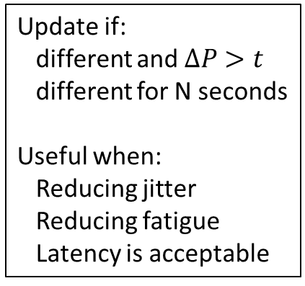
Approaches to Frequency
Now Playing…
Now Playing…
Now Playing…
Now Playing…
>>
Whenever Prediction Changes
For Significant Changes
Interaction Budget
Model User
Every second:
Call Model
Update UX
Useful when:
Realtime control
Extreme change
High-quality model
Update if:
different and $∆P>t$
different for N seconds
Useful when:
Reducing jitter
Reducing fatigue
Latency is acceptable
No more than:
N per session
N per minute
Useful when:
Testing interactions
Reducing fatigue
Gathering Data
When P(accept) > X%:
Useful when:
Users express interest
Low / High mode
Worth the complexity
Backstop: Provide user a way to initiate interaction

Slide 16
Value of Success
Interaction Valuable to User if…
Interaction Valuable to You if…
Noticed that it happened
Cares that it happened
Connects outcome to intelligence
Feels it was in their interest
Thinks the system is cool
Increases engagement
Improves sentiment
Causes user to give you money
Creates good training data

Slide 17
Cost of Failure: Mitigating Mistakes
Knowing there is a Mistake
The Cost of Mistakes
Mitigating the Mistake
User can recover from the damage if they do notice
Double checking intelligent system’s work
  Reduced value of success
  Loss of trust
  Fatigue
User can’t blame the intelligent system if they don’t notice…
Users don’t really care
Users waste a few seconds
Costs the user money
Costs you money
Hurts Engagement / Sentiment
Undo experience
Manual undo
Support escalation
Other options
  Delay the action
  Avoid bad mistakes altogether
  Limit Interactions

Slide 18
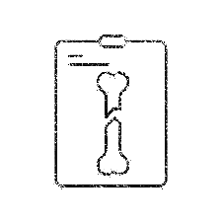
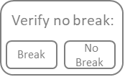
Example of Balancing: Break Finder
Model Quality
Forcefulness
Frequency
Value
Costs
Poor
High Precision Threshold
Less time per scan
Doctor becomes too reliant
Annotate
Doctor starts ignoring it
Great training data
Good
High Recall Threshold
Patient untreated
Prompt
Triage out obvious scans
Patient overtreated
Summary of Last Week:
- Treated 47 breaks
- Wasted 782 x-rays
Every Interaction
Better than Human
Fewer overall mistakes
Hospital Sued
OK
Automate

Slide 19
Summary
Goals of Intelligent Experience
Balancing Intelligent Experiences
Present predictions to the user
Achieve User & System objectives
Minimize intelligence flaws
Create data to grow the system
Hard Because of:
  Mistakes
  Change
  Human Factors
Forcefulness
Frequency
Value of Success
Cost of Failure
Quality of the Intelligence
Change can feel like a mistake – even when it is for the good…

